Slide 1
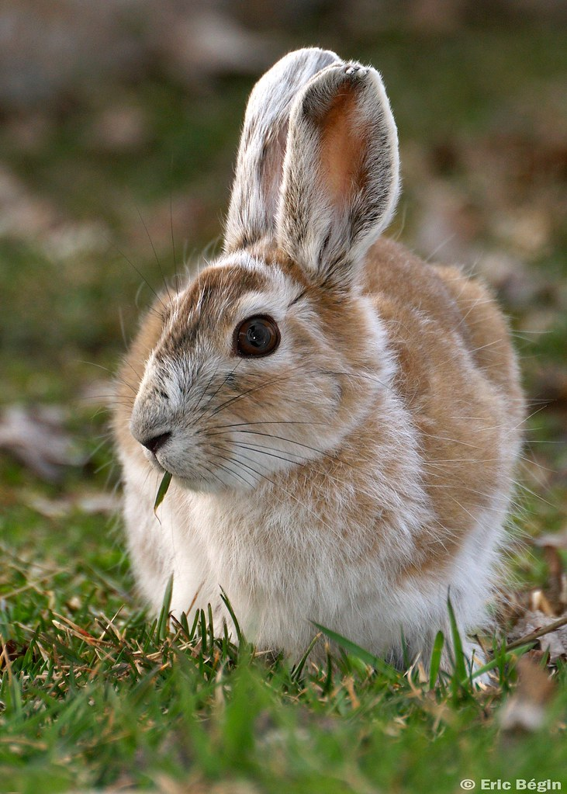
Top-down control or Bottom-up release: Evidence for predation‘s grip on prey numbers
Species Interactions & Coexistence
Vaghadia Saket Dilip, Singh Angleen, Mejsnarová Veronika, Kerkhoff Sigrid

Slide 2
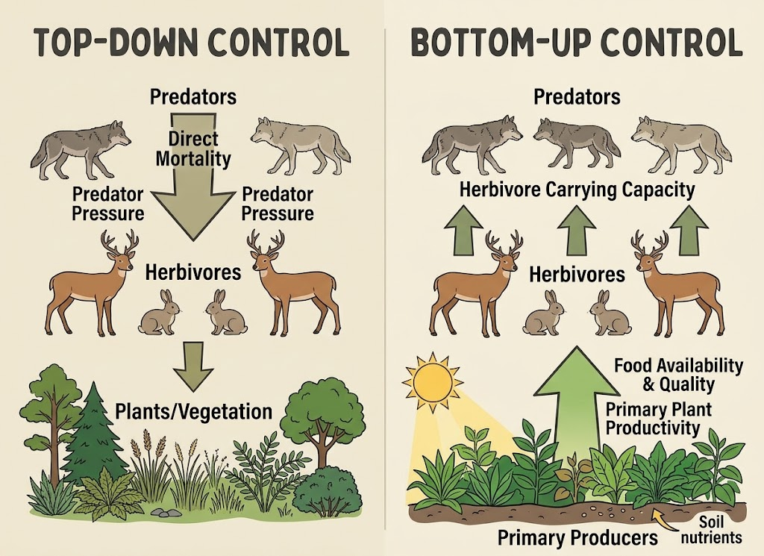
Ecological Concepts
TOP-DOWN CONTROL
Predator pressure directly regulates prey abundance and limits population growth
BOTTOM-UP CONTROL
Food availability, food quality, and primary plant productivity dictate herbivore carrying capacity
Image made by AI

Slide 3
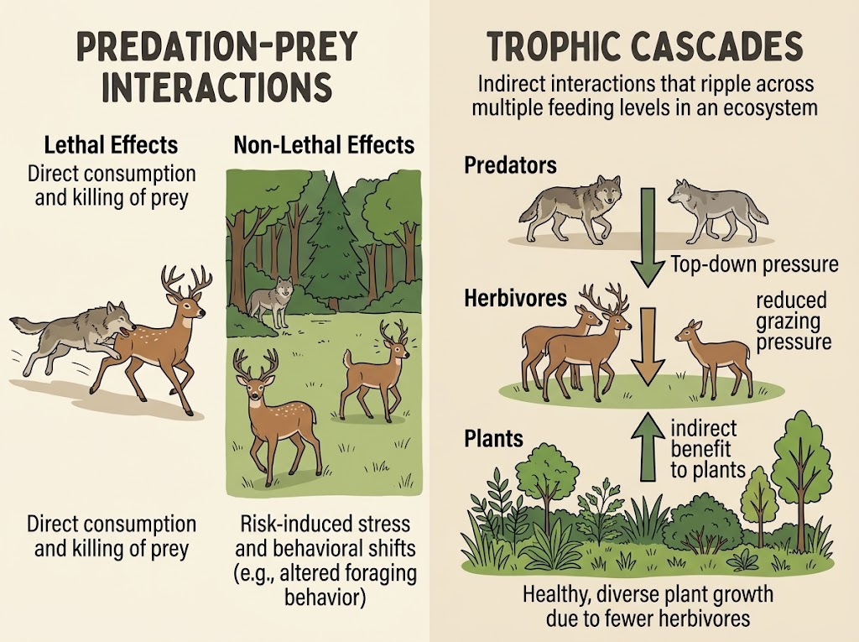

Ecological Concepts
PREDATION-PREY INTERACTIONS
LETHAL EFFECTS
Direct consumption and killing of prey
NON-LETHAL EFFECTS
Risk-induced stress and behavioral shifts
Trophic Cascades
Image made by AI
Indirect interactions that ripple across multiple feeding levels in an ecosystem

Slide 4
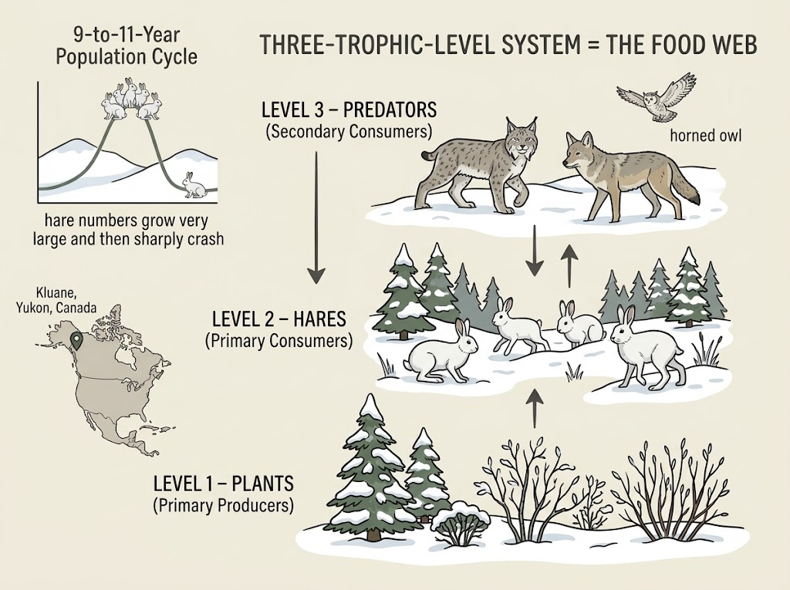
Study System Overview
Snowshoe hare (Lepus americanus) in the boreal forest of Kluane, Yukon, Canada
A regular 9-to-11-year population cycle where hare numbers grow very large and then sharply crash
Three-Trophic-Level System = THE FOOD WEB
LEVEL 1 – PLANTS
● Primary Producers
LEVEL 2 – HARES
● Primary Consumers
LEVEL 3 – PREDATORS
● Secondary Consumers
Image made by AI

Slide 5
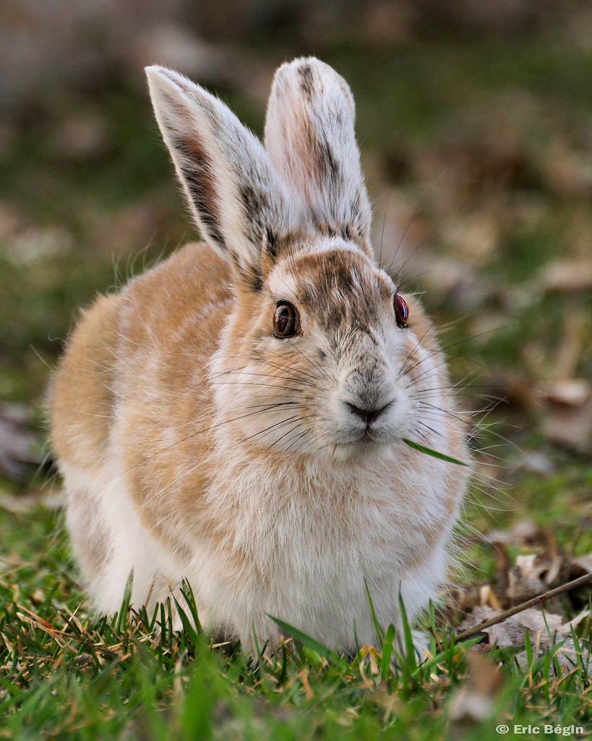
PAPER 1 | 1995
Impact of Food and Predation on the Snowshoe Hare Cycle
Charles J. Krebs and colleagues
Science, 269 (5227), 1112–1115 (1995)
Purpose:
To investigate how food availability and predation influence snowshoe hare populations.
Study location:
Kluane Lake region, Yukon, Canada

Slide 6
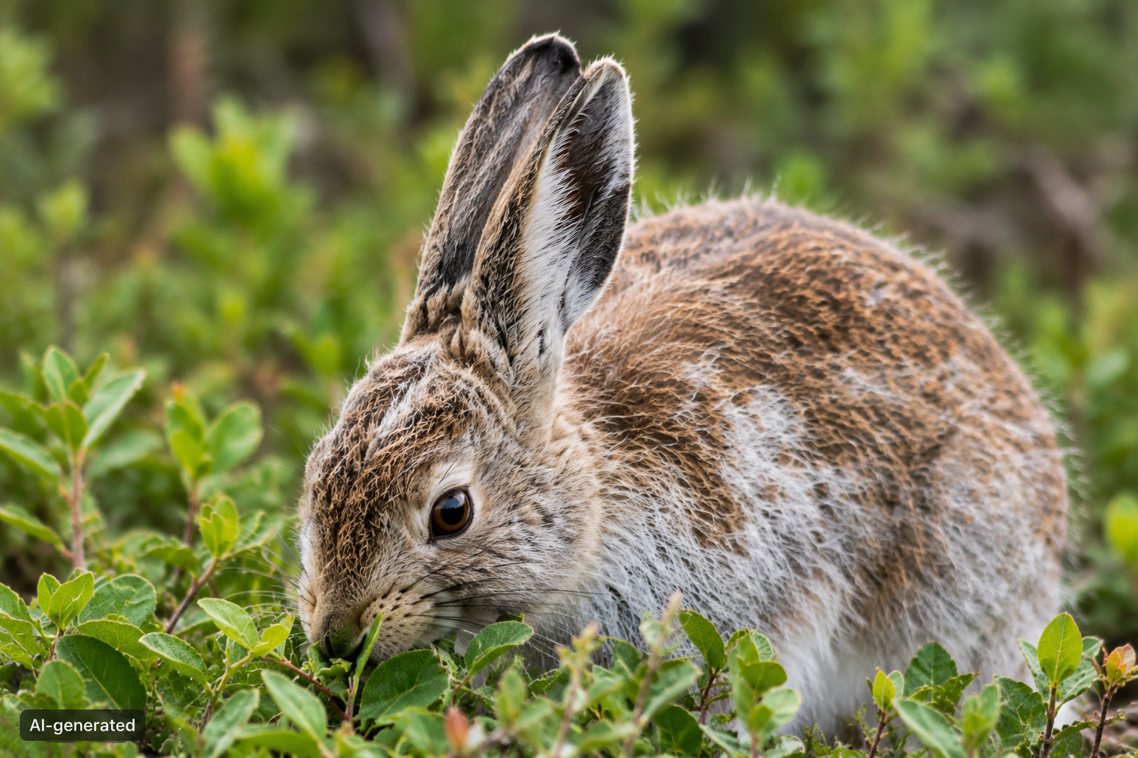
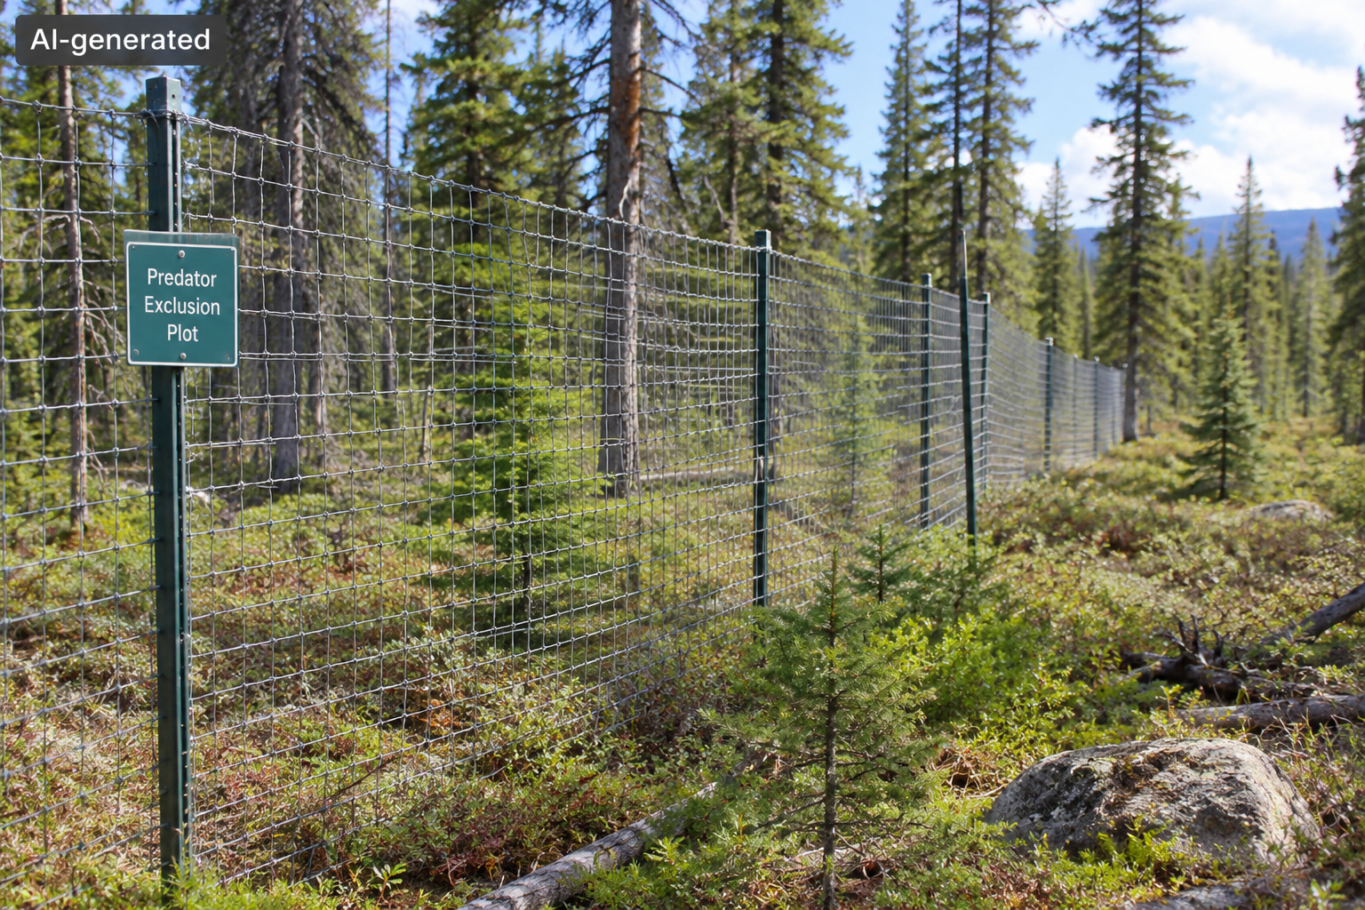
How Did the Researchers Test it?
Researchers compared forest plots with different experimental treatments.
1. Control
No extra food; predators had access.
2. Food addition
Extra food was provided to hares.
3. Predator exclusion
Fences reduced access by mammalian predators.
4. Combined treatment
Extra food and predator exclusion together.
Additional test: Forest Fertilization
Separate plots were fertilized to test whether increasing plant growth affected hare density.

Slide 7
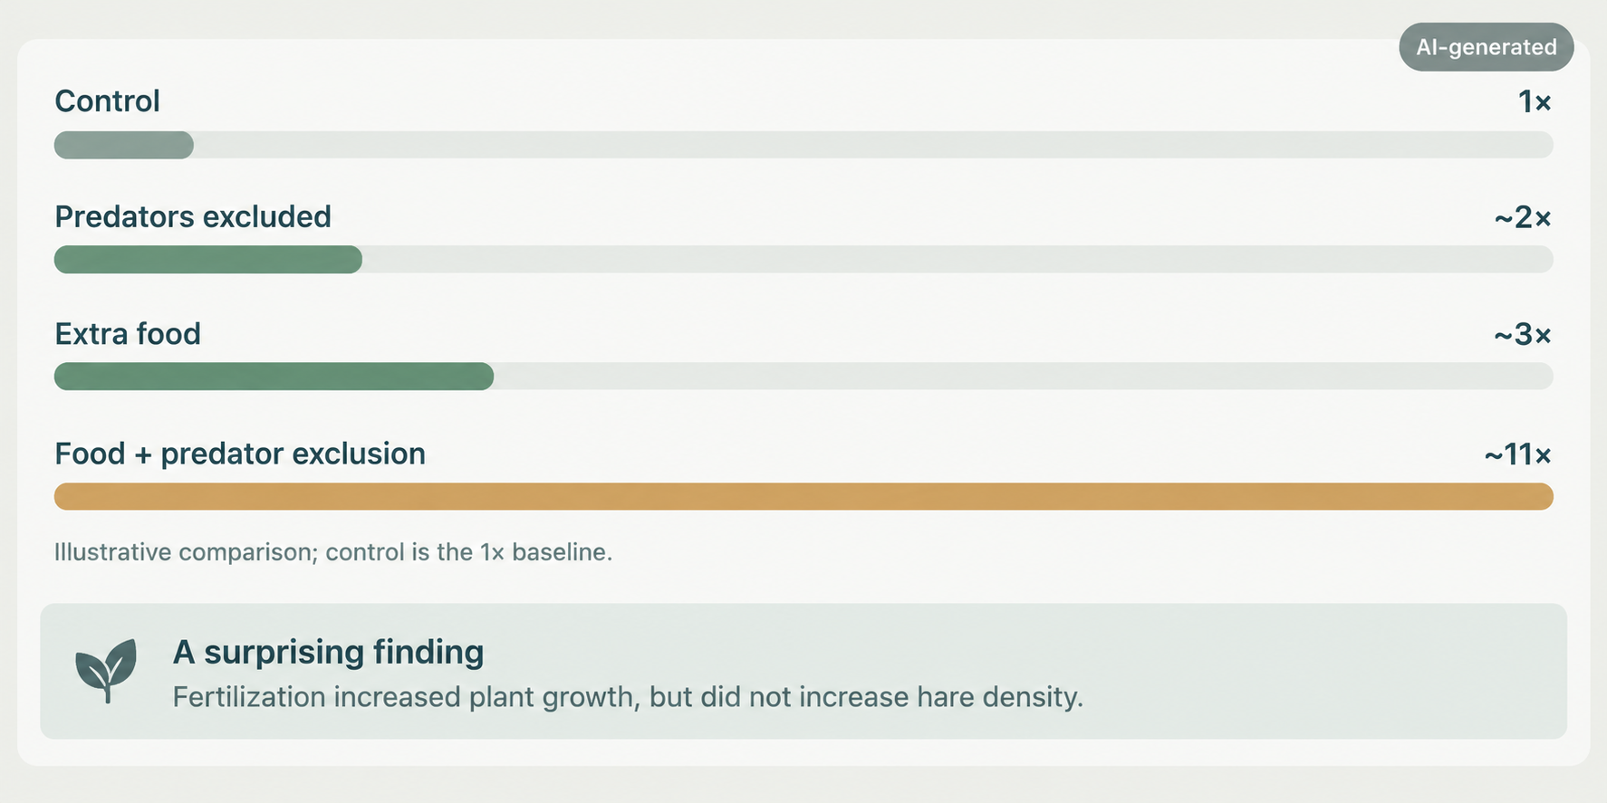
What Were the Main Results?
Approximate hare-density differences reported during the peak and decline phases.
Important result: The combined effect was greater than either treatment alone
Source: Krebs et al. (1995), Science, 269(5227), 1112–1115.

Slide 8
What Do The Results Tell Us?
Krebs et al. (1995) — Interpretation
Top-Down Control
Predator exclusion increased hare density, supporting an effect of predation.
Bottom-Up Effects
Adding food increased hare density, showing food availability also matters.
Interaction
Food + predator exclusion produced the largest increase (~11×).
Conclusion: neither food nor predation alone explains the full cycle.

Slide 9
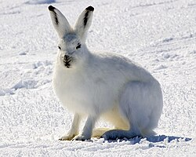
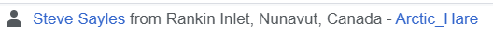
PAPER 2 | 2026
Demographic mechanisms of snowshoe hare population cycles in Yukon, Canada.
Madan K. Oli and colleagues.
Research question: which demographic processes drive population growth and decline?
Study area: Kluane Lake, Yukon, Canada.

Slide 10
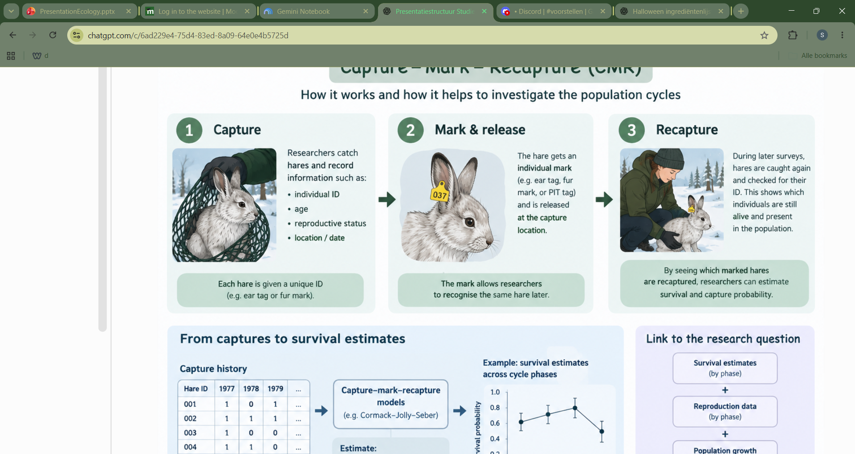
Methods: how did they investigate?
Data from 1977-2020.
Snowshoe hare population cycles 9-11 years
More than 20,000 captures (more than 7,000 individual hares).
Method: capture-mark-recapture models
Population growth, survival and reproduction analysed across cycle phases.
Image made by AI

Slide 11
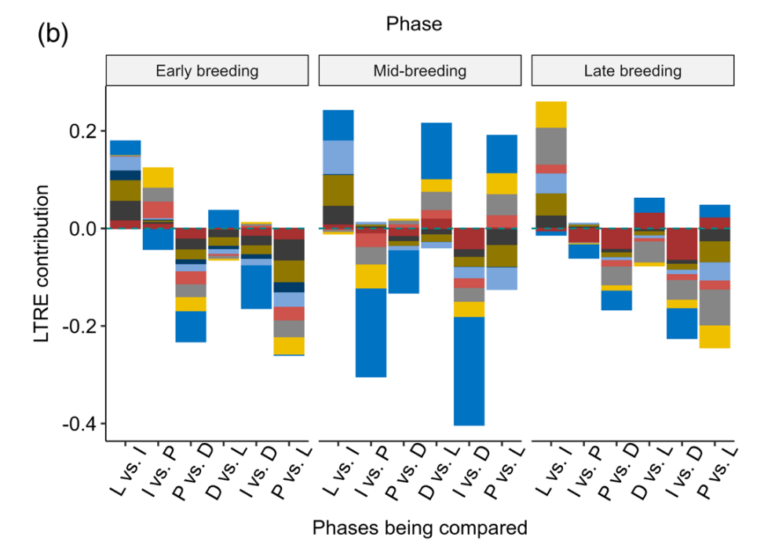
Results
Main findings:
Survival = higher during population increase phase.
Population decline because of reduced survival, mainly before weaning.
Dark blue: pre-weaning survival, yellow: juveniles survival
Population growth and decline. Olive green and black: females (becoming) reproductive
Adult female survival
Oli, M. K., Kenney, A. J., Boonstra, R., Boutin, S., Murray, D. L., Jung, T. S., Hines, J. E., & Krebs, C. J. (2026). Demographic mechanisms of snowshoe hare population cycles in Yukon, Canada. Journal of Animal Ecology, 95, 21–38. https://doi.org/10.1111/1365-2656.70169

Slide 12
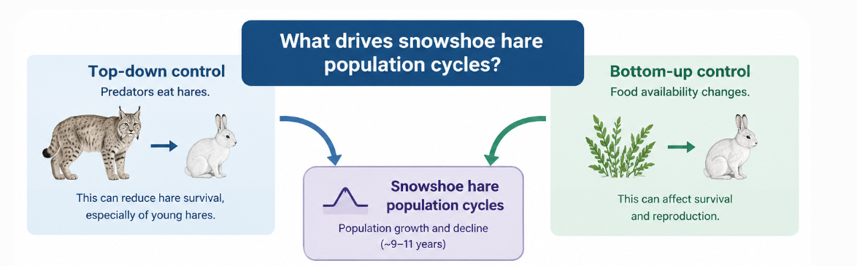
What do the results mean for top-down and bottom-up control?
Predation
Survival, phase of the cycle.
Reproduction and pre-weaning survival
The 1995 experiment and 2026 demographic study provide complementary evidence.
Image made by AI

Slide 13
Two Studies, Two Kinds of Evidence
1995 · Krebs et al.
2026 · Oli et al.
EXPERIMENTAL EVIDENCE
Method: Food addition + predator exclusion
Finding: Strong interaction between both factors
Limitation: Population decline was delayed, not prevented
DEMOGRAPHIC EVIDENCE
Method: 43 years of population data
Finding: Survival and reproduction drive population changes
Limitation: Ecological causes not directly tested
1995 tested ecological pressures; 2026 explained the demographic processes behind population changes.
Sources: Krebs et al. (1995); Oli et al. (2026).

Slide 14
Why Didn't the Population Decline Stop?
KREBS ET AL. · 1995
OLI ET AL. · 2026
The unexpected result
Food + predator exclusion increased hare density
Population still eventually declined
Birds of prey remained, and hares could move outside protected areas.
A deeper insight
Survival and reproduction shape population cycles
Pre-weaning survival is crucial during declines
Causes of reproductive changes remain unclear
The bigger picture
Increasing hare numbers does not necessarily mean the natural population cycle has been eliminated or fully explained.
Sources: Krebs et al. (1995); Oli et al. (2026).

Slide 15
Final Verdict: What Have We Learned?
What the evidence supports
What remains uncertain
Predation strongly influences hare survival
Food and predation interact
Survival and reproduction shape population cycles
Causes of reproductive changes.
Why do hare populations remain low for several years?
Do similar demographic patterns occur in other cyclic populations?
THE FINAL ANSWER
Predation plays a major role in controlling hare populations, but food availability and demographic processes are also essential to understanding the cycle.
Sources: Krebs et al. (1995); Oli et al. (2026).

Slide 16
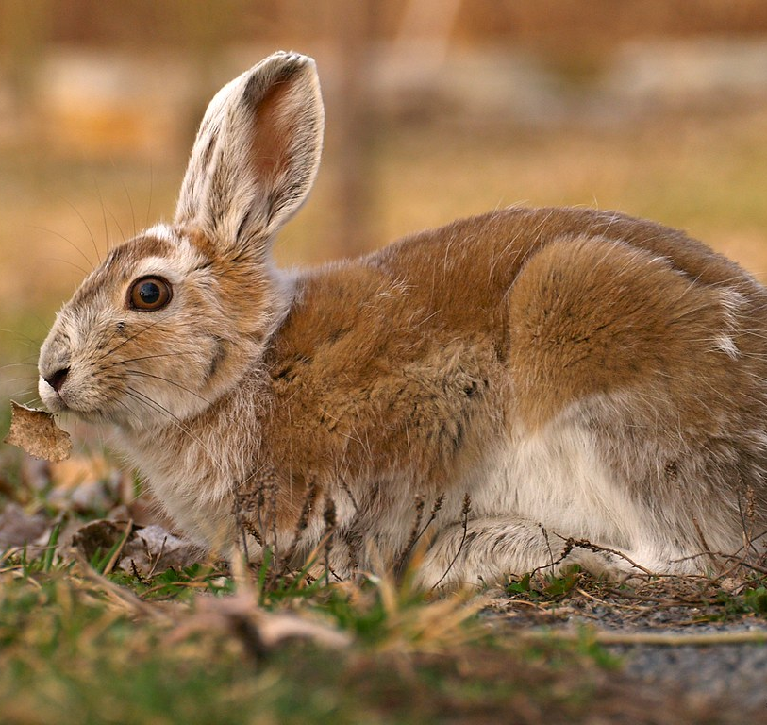
Thank You for your attention!
Any Questions?

